Slide 1

Prediction of skewed biased Ozone Days
By: Shamil, Richard, Raphael
3253 –Machine Learning
Date: December 03, 2019

Slide 2
Background & Motivation
Ozone Action Day: Declared by municipality/state when severe weather conditions combined with pollutants form high levels of ground level ozone that may cause harmful effects to health
Ground Ozone is formed from sophisticated physical and chemical reactions.
Sources of production include factories, vehicle emissions, chemical plants and other industrial sources
Even short term exposure to ozone can cause asthma, chest pain, coughing. Long term may cause lung cancer. In addition, causes harm to multiple ecosystems (farming, tourism, vegetation etc)
Motivation: Build a highly accurate ozone level alarm forecasting model for air quality experts i.e. classification of ozone day vs normal day

Slide 3
Data Nature
Ozone level dataset provided by Texas Commission of Environmental Quality
Covers the geographic areas of Houston, Galveston and Brazoria
Time series data ranging from 1998-2004
Dataset consists of 74 sparse features, relatively small training size, skewed classes (6% ozone days vs 94% normal days)
Possibly, many irrelevant features that will need to be eliminated or reduced via dimensionality reduction

Slide 4
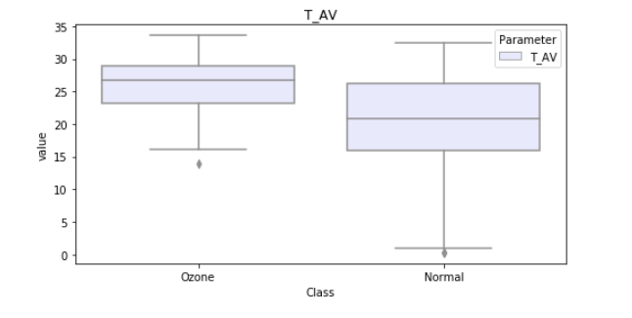
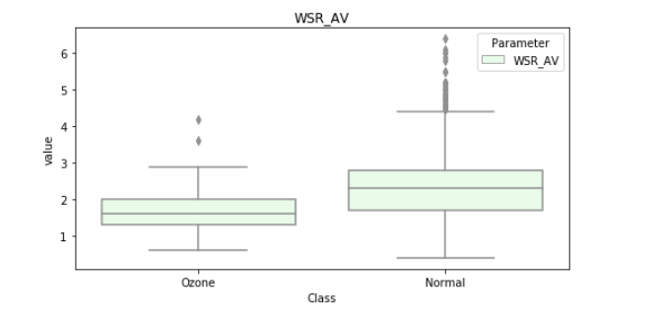
Wind and Temperature BoxPlots

Slide 5
Conclusion

Slide 6
Reference
Zhang K, Fan W, Yuan X (2008). Forecasting skewed biased stochastic ozone days: analyses, solutions and beyond, Knowledge and Information Systems. Department of Computer Science, Xavier University. Retrieved from http://citeseerx.ist.psu.edu/viewdoc/download?doi=10.1.1.435.8329&rep=rep1&type=pdf

